Slide 1
7th Grade Language Arts
Notes:
Tracy

Slide 2
Mrs. Johnson, Seventh Grade Language Arts
17th Year at BMS teaching Language Arts
Undergraduate Degree in Journalism from Georgia Southern University
Post Baccalaureate work for teacher certification and Masters in Education from University of North Georgia
Education Specialist in Curriculum and Instruction from Piedmont College
Reading Endorsement
Gifted Endorsement

Slide 3
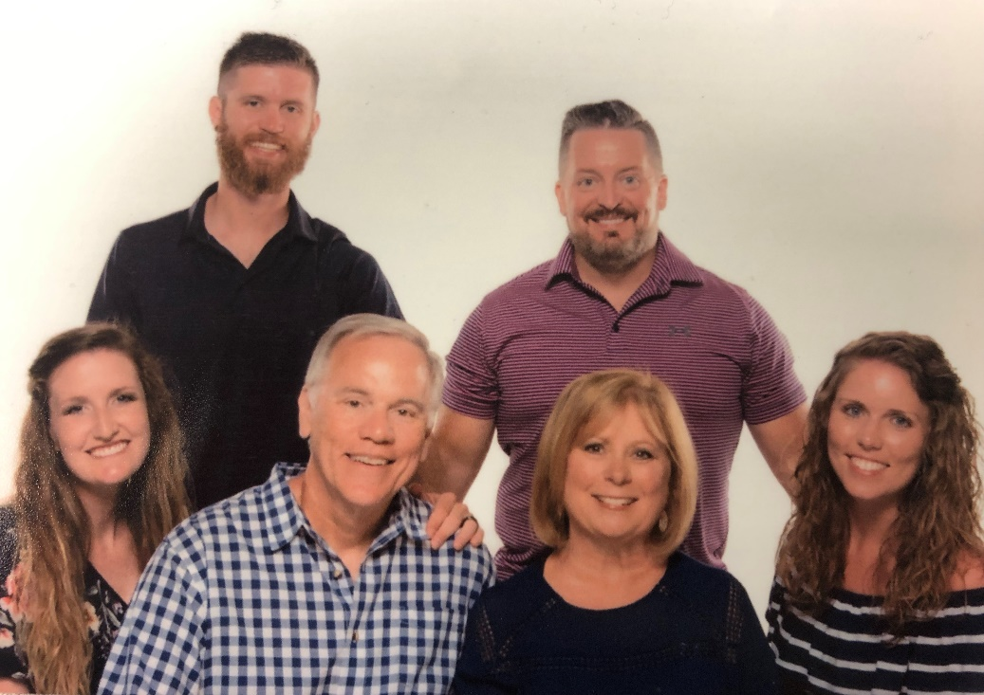
My Family
Married to my college sweetheart, Wayne Johnson for 38 years
Wayne is Congregational Pastor at First Baptist Church of Buford
Two children: Ashley and Matthew
Ashley is dance teacher and choreographer at Buford High School. She is married to Bryant Smith.
Matthew is P.E. teacher at Buford Acadeny and is the cross country coach at Buford High School. He is married to Tia, who is also a runner.

Slide 4
Contact Information for Mrs. Johnson
Email:
lea.Johnson@bufordcityschools.org
Teacher Website:
www.bufordms.org/teams/7thgrade/Lea Johnson
http://bmsjohnson.weebly.com/

Slide 5
Overview
Grammar and Mechanics
Daily Grammar Practice (DGP)
Various grammar units throughout the year
Literature Units
Relationships
Accepting Others’ Differences
Discovery
Overcoming Challenges or Adversity
Each unit will incorporate a variety of genres including; fiction, non fiction, poetry, myths, and drama
Independent Reading
Independent reading and literature circles each nine weeks.
Notes:
Tracy

Slide 6
Membean
Vocabulary program tailored to student reading level
Online vocabulary program
15 minutes a day, three days a week
Week runs from Monday through Sunday
Done through Flex classes each week
If student is in a specialized Flex class (Student Leadership, Band, Chorus, etc..), he/she will be expected to complete Membean outside of school.
Students will be expected to use Membean words in writing and recognition while reading in class.

Slide 7
Writing for 7th Grade Language Arts
Narrative
Argumentative (Persuasive)
Comparative
Expository (Informative)
Oral Presentations
Response to Literature
Journal Responses
Writing is both short and extended constructed response
Notes:
Tracy

Slide 8
Friday Focus
Milestone-focused activities
Each Friday, students will engage in specific lessons focusing on standards for Georgia Milestones
These lessons will be in addition to the regular seventh grade language arts curriculum
Additional practice can be done at home through on line programs such as Common Lit, IXL, ReadWorks, and Membean.

Slide 9
Homework Assignments
Students will have grammar homework when practice is needed.
Students will have writing projects that will require some time outside of class to complete.
Students are expected to read daily and will have in-class assignments on independent reading due dates.
The BMS Late Policy for seventh grade will apply to all assignments. Students will have two days to turn in late work at 10 points off per day. Work will not be accepted after the second late day. NO late work for math is accepted.

Slide 10
Grading Weights:
Summative Assessments: 50%
(Tests, Projects, Papers, Performance Tasks)
Formative Assessments: 35%
(Daily Work, Homework, Quizzes)
Nine Week Benchmark Test 15%
Notes:
Tracy

Slide 11
Tips For Parents
Grammar: https://www.dgppublishing.com/grammar.php http://classzone.com/books/lnetwork_gr07/index.cfm
Independent Reading Comprehension Questions:
What is the exposition of your book (setting, central conflict, characters)?
Use adjectives to describe your main character. What is his/her personality?
What are some interesting events that have happened? Did anything surprise you?
What is an internal or external conflict in your book?
What is the theme or life lesson?
Is there any foreshadowing (hints about the future) that helped you make predictions?
Check teacher’s website regularly (www.bufordms.org/teams/7th grade)

